Slide 1
Capstone Progress Report
Winter 2017
Andrew Ekstedt
Scott Merrill
Scott Russell

Slide 2

The Secret Bunny Team:
Privacy Preserving Cloud & Email Encryption
Notes:
SR

Slide 3
Project overview

Slide 4

Privacy Preserving Cloud & Email Encryption
The ”Privacy Preserving Cloud, Email and Password Manager” Capstone project is a research-oriented project that aims to implement the DSSE scheme proposed by David Cash.
CC0 Creative Commons
No attribution required

Slide 5
Earlier term recap

Slide 6
Current Progress

Slide 7

What we finished this term
DSSE Basic
DSSE piPack
Tokenization
Basic Benchmarking
Bit Matrix Benchmarking
Overall Improvements

Slide 8

Future plans

Slide 9
Plans for Spring Term
More benchmarking
More optimization
Prepare for Expo

Slide 10
Plans: Optimizations
Pointer → L2 Pointer
Stretch goal: parallelization

Slide 11
Plans: More Benchmarking
Specialized Benchmarking: see https://eprint.iacr.org/2018/247.pdf
Larger Datasets
Clusion
Basic → PiPack → Pointer → L2 Pointer

Slide 12
Plans: Expo
Prepare for Expo
Email Integration
Or basic APP for demonstration purposes
Fix our poster design to meet requirements
More Research
Final Report

Slide 13

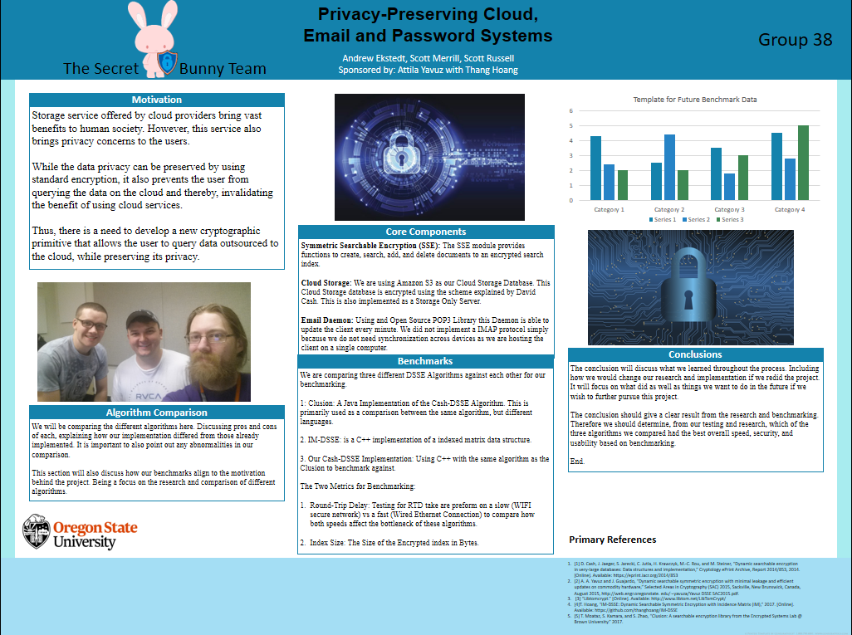
Adjust Poster to match OSU requirements
Create demo for presentation at the Engineering Expo

Slide 14

Retrospective

Slide 15
Problems
Not following poster format.
Needing to change requirements document
Meeting problems
TA MIA
Attila busy
Team communication
Meeting conflicts (Crypto hw)
AppleDouble files!!!

Slide 16

What went well?
Basic Benchmarking
PiPack implementation (yay)
Our code compiles (still!)
Adjusting Project Requirements

Slide 17
Live Demos

Slide 18
General improvements
Persistence
Nicer command-line interface

Slide 19

Preliminary benchmark results Demo
Benchmarking Basics for DSSE and Bix Matrix
Show Bit Matrix search time for a specific check
Show DSSE basic client_test.
Show Benchmark PDF files with aggregated data (100 runs, 100,000 unique items in a single dataset [small])

Slide 20
Pipack
Code review - what changes were made
Setup functionality
Search functionality
Demo
Compile
Setup - 6 testfiles
Seach - does it return what is expected?

Slide 21
Conclusion

Slide 22
Image Sources
https://pixabay.com/en/growth-progress-graph-diagram-3078543
https://pixabay.com/en/rabbit-characters-pink-cute-animal-2403904/
https://pixabay.com/en/whiteboard-white-board-blank-303145/
https://pixabay.com/en/cyber-security-hacker-security-3194286/
https://pixabay.com/en/children-win-success-video-game-593313/
All images are licensed under Creative Commons CC0
Notes:
AE

